Slide 1


Introducing CAMIS
Comparing Analysis Method Implementations in Software
Chi Zhang, PhD - on behalf of CAMIS WG
UseR! 2024 2024.7.10

Slide 2




About me
Co-lead of CAMIS project since 2024.01
Statistician and part-time lecturer at Faculty of Medicine, University of Oslo
R developer, use Quarto for various things - that’s another story!
Today: CAMIS
Disclaimer: opinions in this talk are all mine and do not reflect that of my employer

Slide 3

How I joined CAMIS
Non-industry statistician / R dev
Was planning a career transition (academia, public health -> ?)
Have been following updates in the pharmaceutical industry - spent a lot of time on LinkedIn
September 2023
Harshal (one of the co-leads) invited me to the project
Not sure about SAS, but I can help with the R part - and they use quarto!

Slide 4
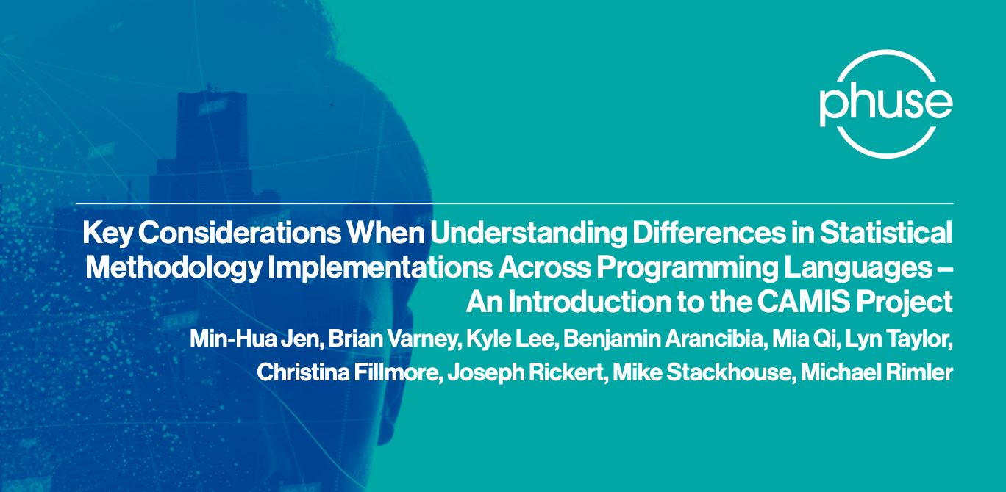

CAMIS
Increase understanding and awareness of analysis result discrepancies across software (R, SAS, Python etc)
Demonstrate the methodology through examples, document in open GitHub repository
Repository location:
https://psiaims.github.io/CAMIS/
Notes:
So what is camis? Our objective is to …
Camis is a part of the phuse DV and OST working group, and has published a white paper (as of last June).
Phuse is the global healthcare data science community.

Slide 5
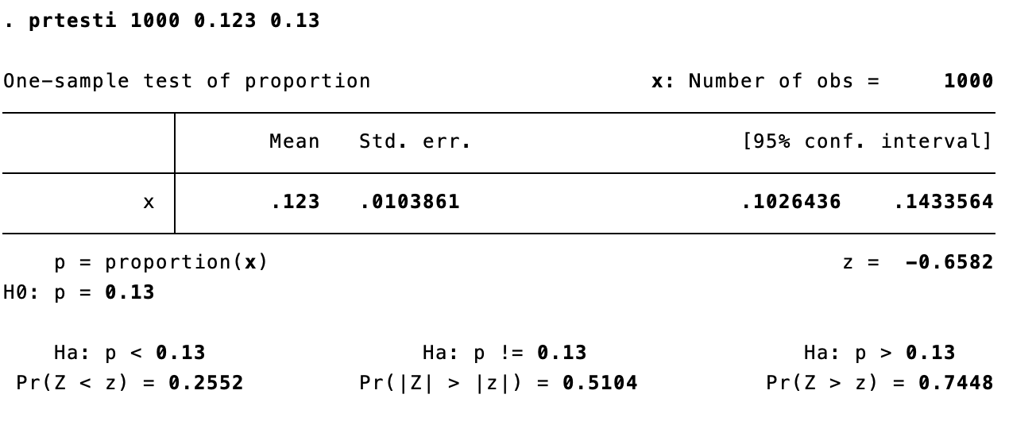
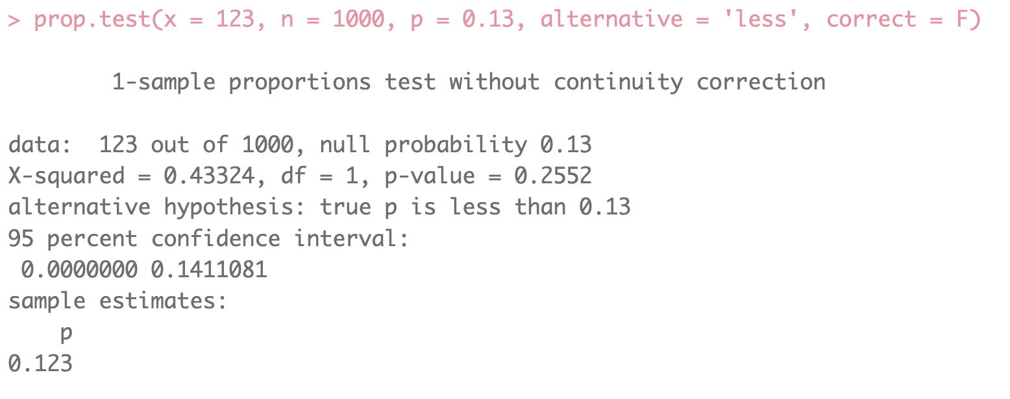
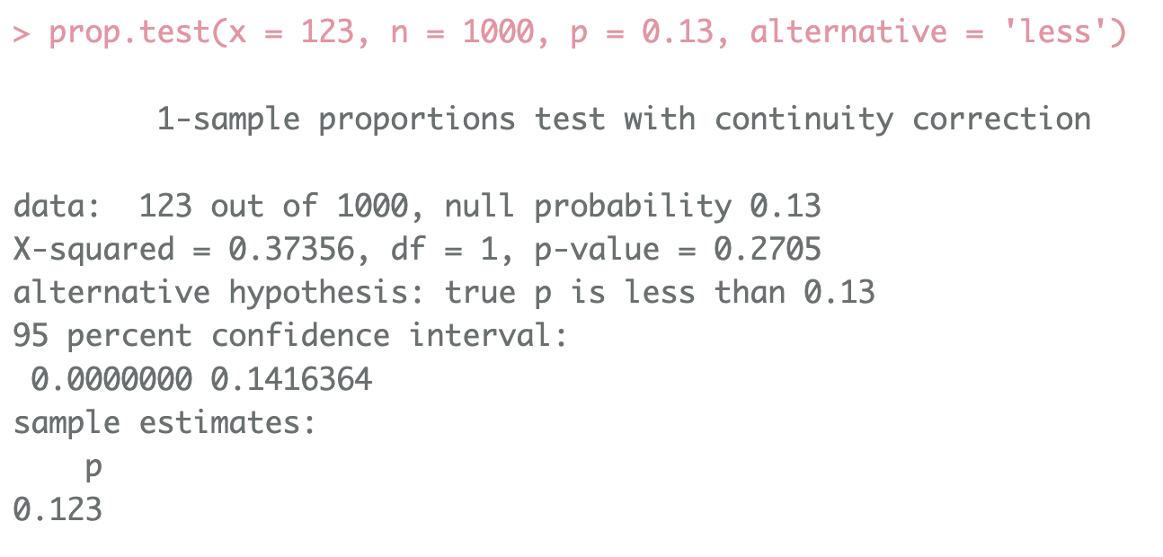
Discrepancies
stata vs R, test for proportions
Shift to open source is also happening in public sector (if not more!) - $$$
The default algorithms under the hood are different
Not well documented in stata
What if the p-values differ around 0.05?
Notes:
So what do we mean by discrepancies. They are actually very common. I’ll give you an example of a simple statistical test, the test for proportions in two languages. As I mentioned I’m a part time lecturer and my department has just made the transition from spss to stata a few years before I joined the teaching team. I had to use stata too. …
But as I use r, I also included the same test. And by the way they are both the default, without any more specification.

Slide 6
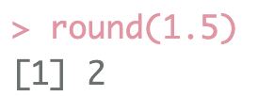
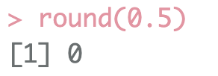
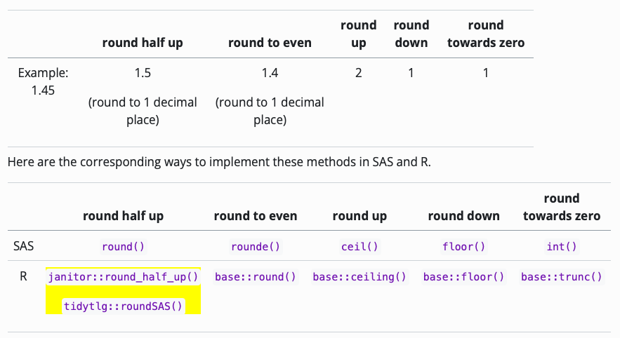
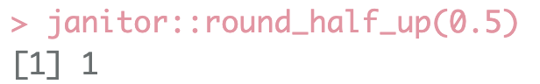
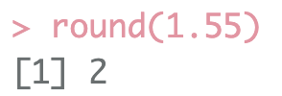
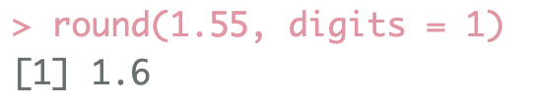

Rounding
In R, round() to the nearest even; in SAS, round() round half up
Pharmaverse blog has an article on this topic
round(1.5) =
round(0.5) =
round(1.55) =
round(1.55, digits = 1) =
Notes:
Another quite famous (but I didn’t know about) example of discrepancies across languages is the rounding.

Slide 7








Why it matters
Shift in industry from SAS to R and open source software, e.g. pharmaverse
In public sector: teaching, medical research and public health, SPSS / stata (even excel!) vs R, python
Do we get the same results? Which is correct, Why do they differ?
Could be different algorithms; default options; floating point numbers; … (@adrianolszewski listed at least 14 different reasons)
When results are different, it leads to uncertainty
Reproducibility challenges already exist even when there’s only one software (set seed, package versioning, inaccessible sensitive data for revision, …)

Slide 8

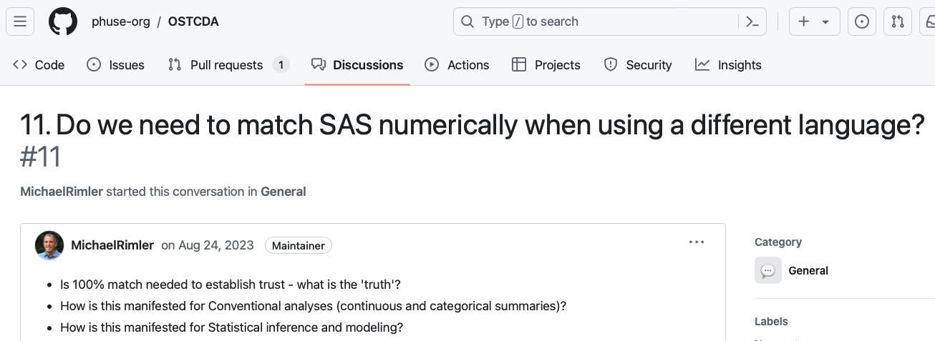

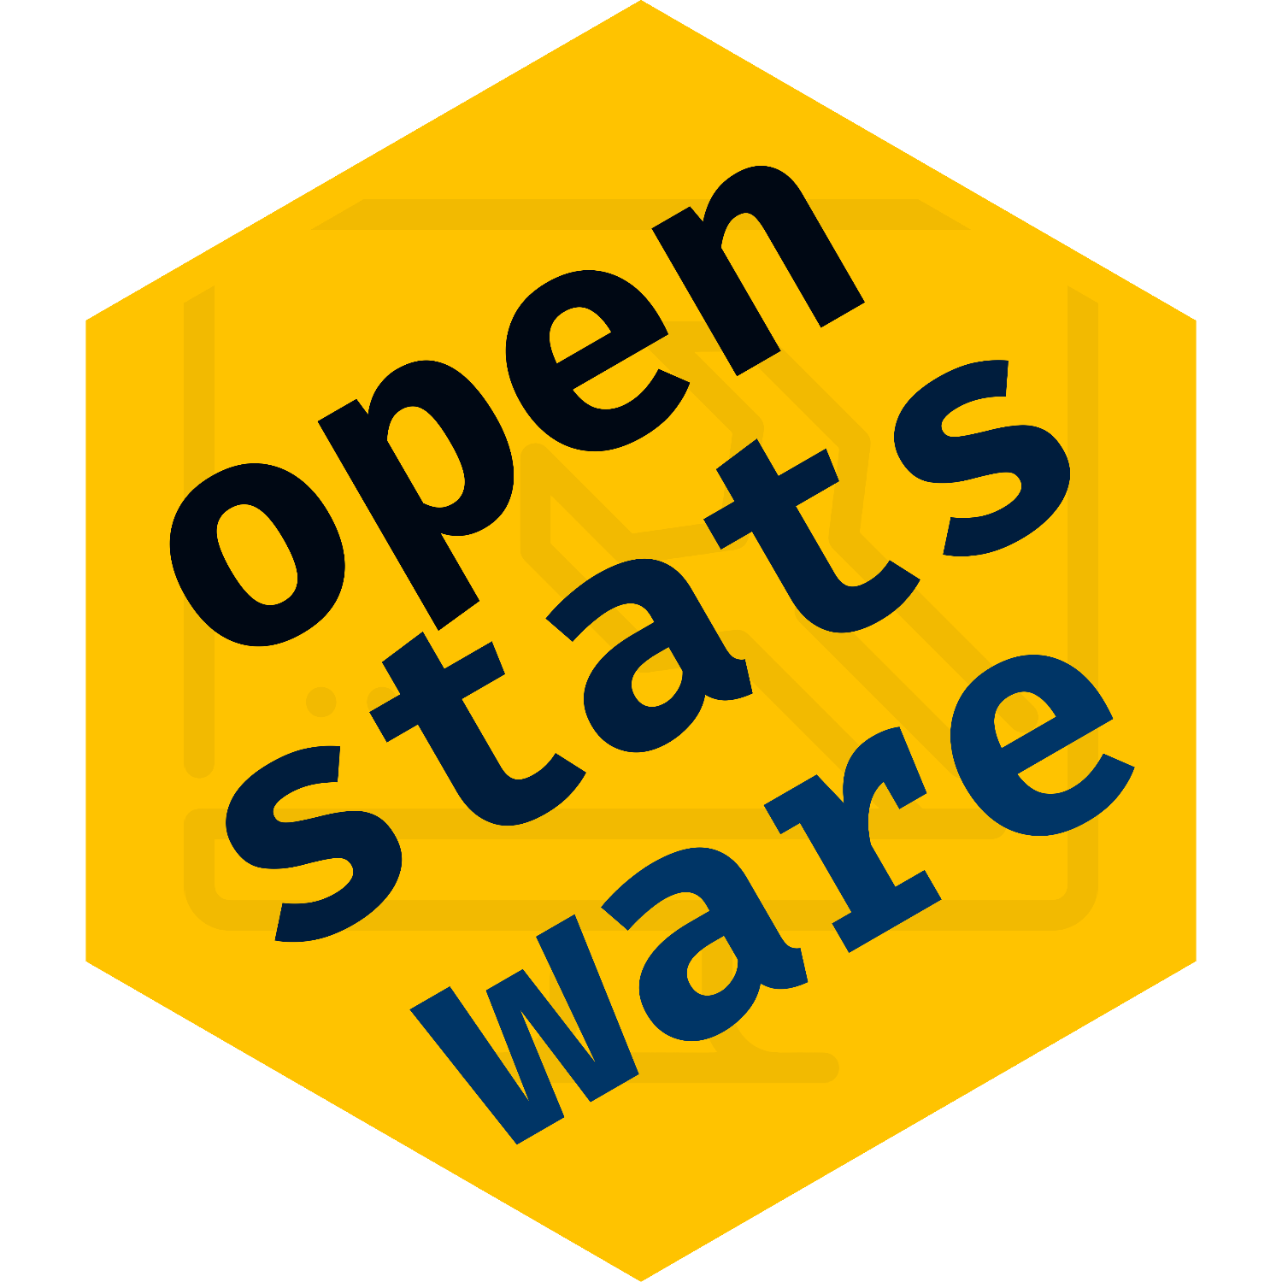


Trust in open source?
Accuracy, reproducibility, traceability (Modernization of Statistical Analytics Framework)
Validation: establish documented evidence which provides a high degree of assurance that procedures consistently produce a product meeting its predetermined specifications
It doesn’t mean we need to match results 100%; but we should know why they are different

Slide 9
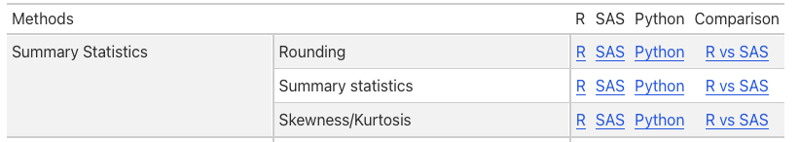
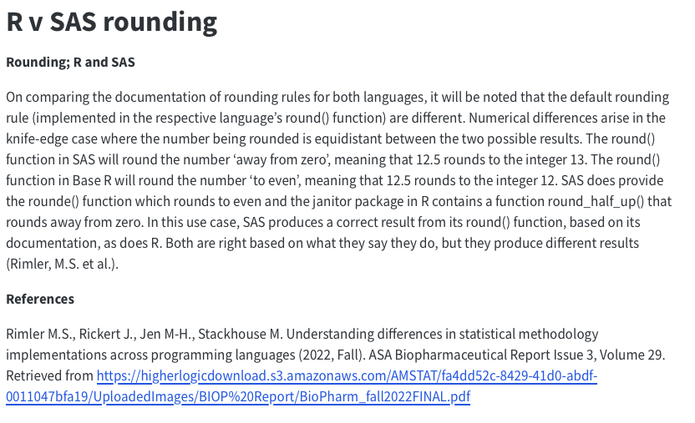
Rounding
In CAMIS
round(1.5) =
round(0.5) =
round(1.55) =
round(1.55, digits = 1) =

Slide 10
Where are we now,
where do we go next?

Slide 11
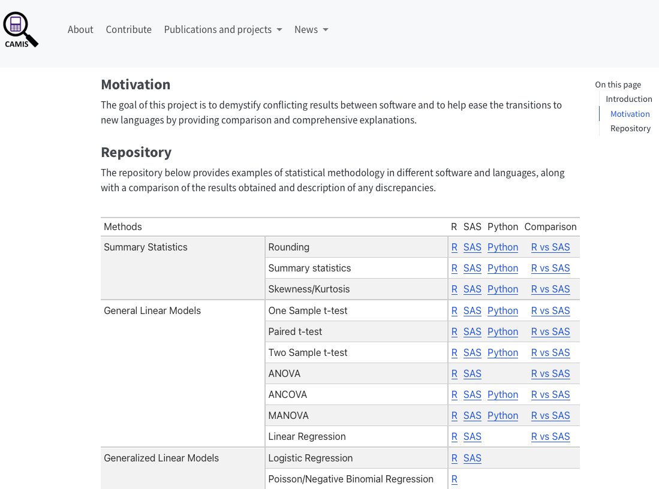
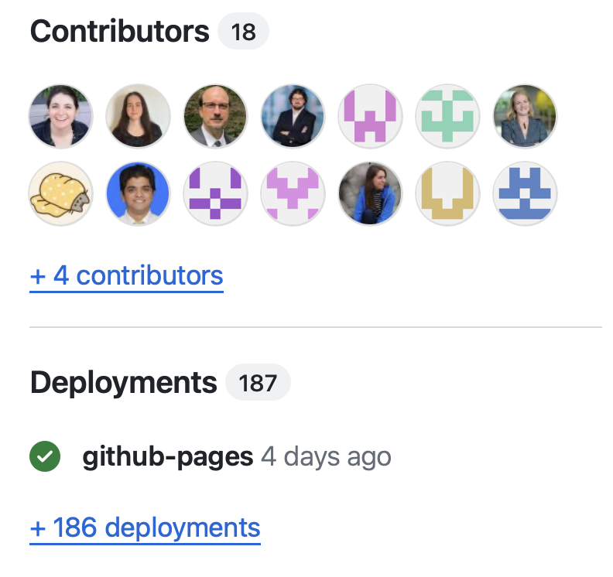
CAMIS today
Many participants on the monthly update meetings (might not directly contribute to the content on GH, but in other ways - discussion, collaboration, presentation)
Documentation in R, SAS, Python

Slide 12
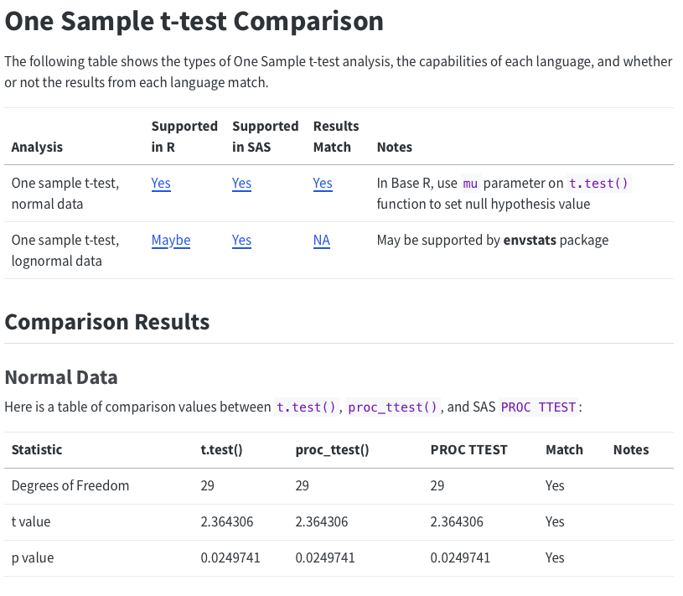
CAMIS today
SAS vs R
Since CAMIS group has a focus on pharmaceutical industry, the comparisons are mostly in SAS vs R
Example page: one sample t-test
Agnieszka (our contributor) has an in-depth analysis on different implementations on Wilcoxon Signed Rank Test - R, StatXact, SAS
Talk recording and slides she gave on R/Medicine 2024 is available on CAMIS website

Slide 13
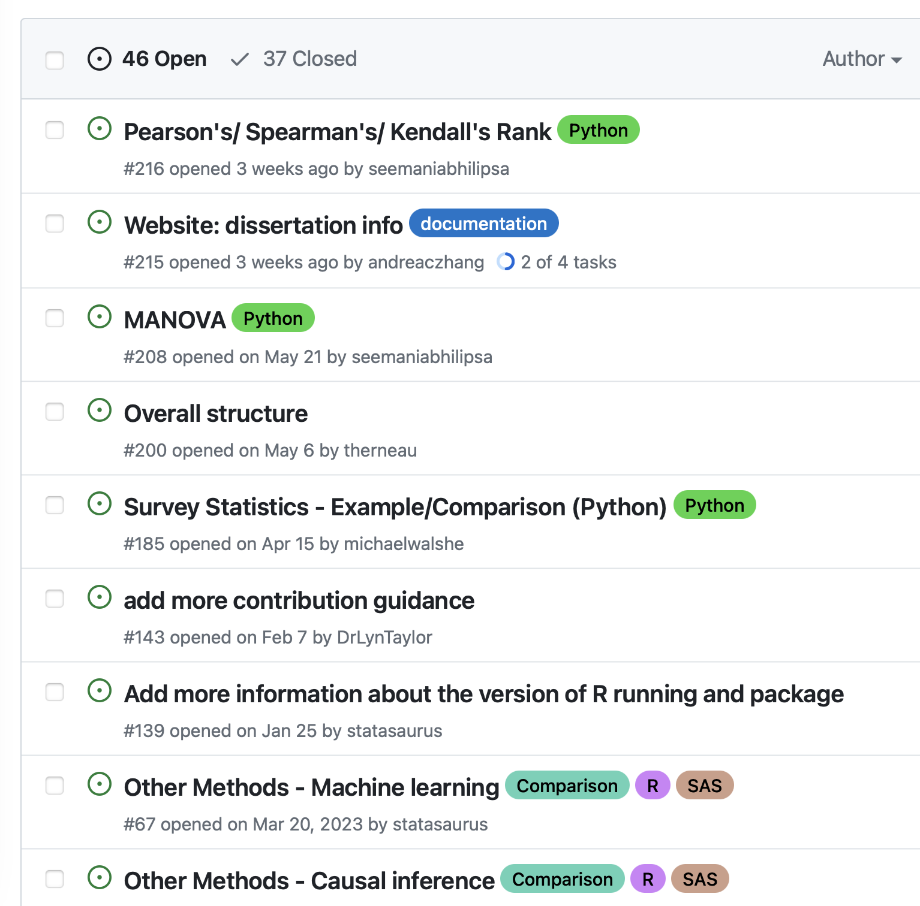
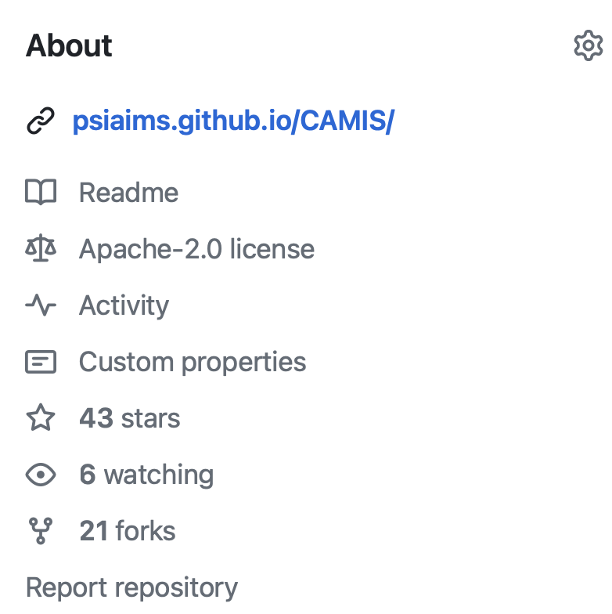
CAMIS today
Closed 37 issues
187 deployments of the website
Still many open issues - we need your help!

Slide 14
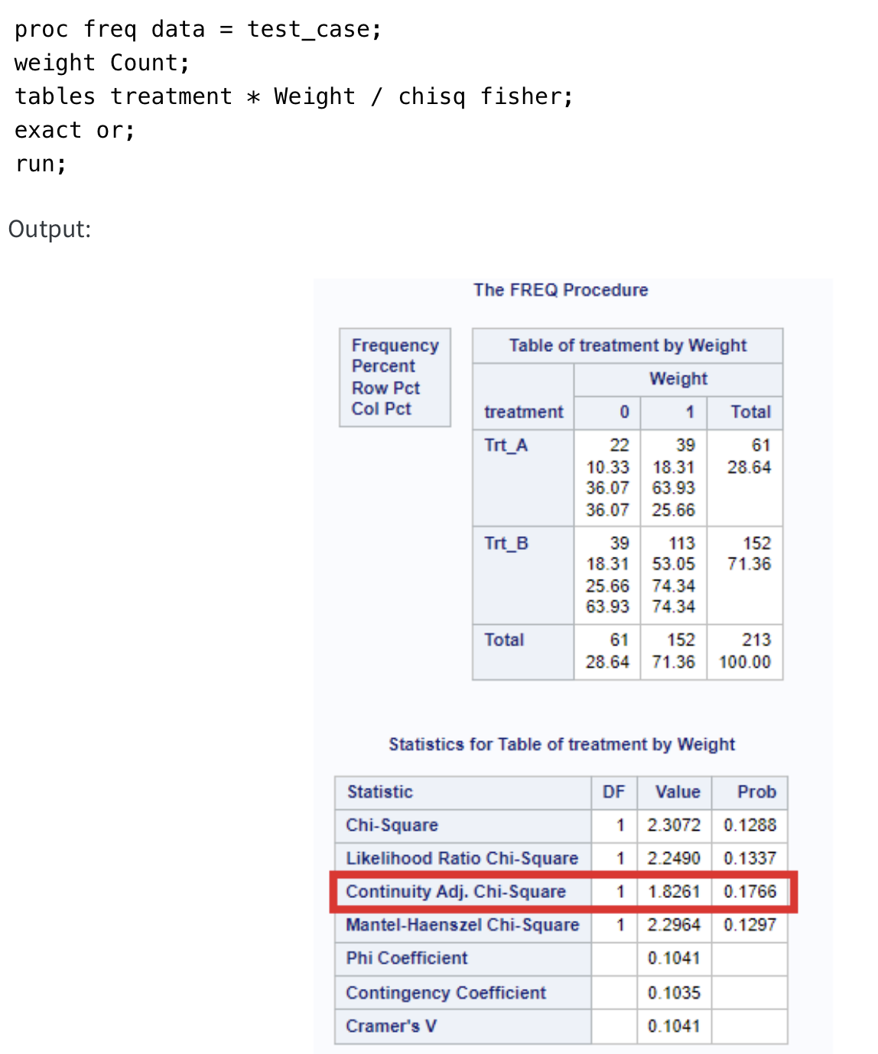
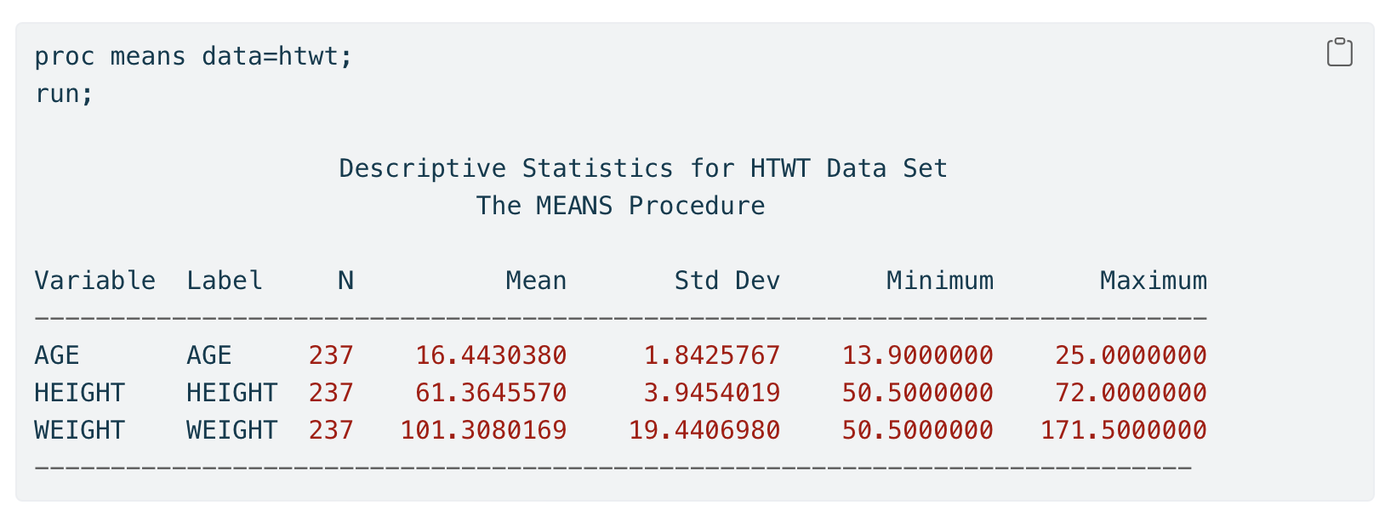
We use Quarto
Quarto has been the publishing and collaboration tool we use
Easy to write articles, render results for multiple language (R, python)
For SAS it is a mix of copy-paste and screenshots
Website deployment is straightforward when only text is edited
R packages and versioning: we’re working on a solution with renv, getting help from posit!

Slide 15
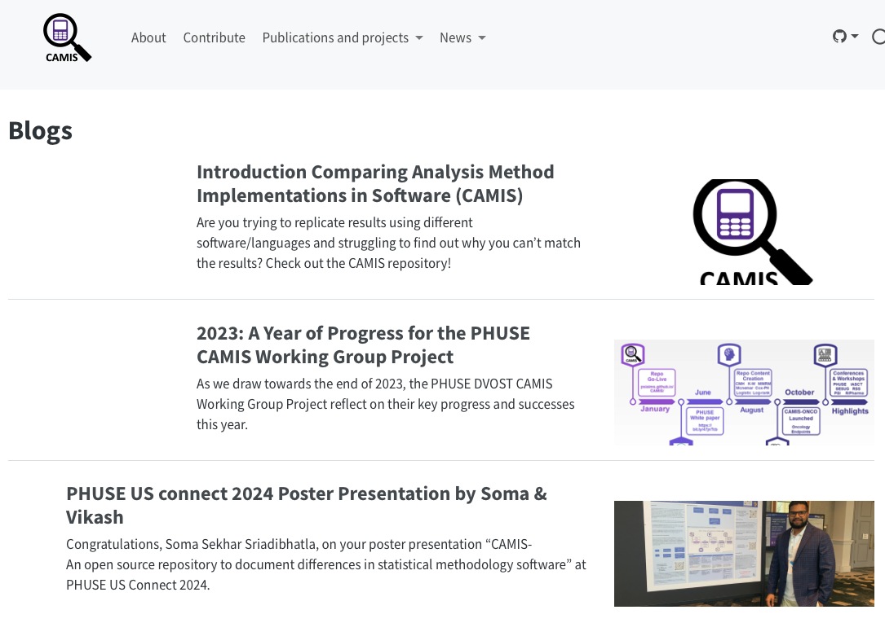
Active and welcoming community
4 co-leads: Lyn Taylor (Parexel), Christina Fillmore (GSK), Harshal Khanolkar (Novo Nordisk), Chi Zhang (University of Oslo)
Community call once per month: discuss open issues, updates
Open and organized: meeting minutes openly accessible
Diverse and great vibes!
We encourage everyone to go out and present our group at conferences and seminars

Slide 16
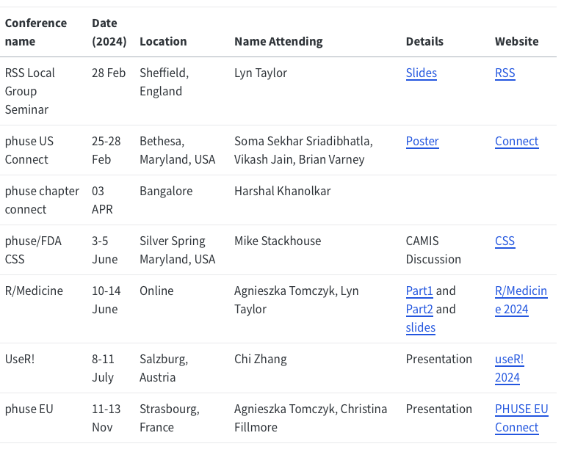
Active and welcoming community
4 co-leads: Lyn Taylor (Parexel), Christina Fillmore (GSK), Harshal Khanolkar (Novo Nordisk), Chi Zhang (University of Oslo)
Community call once per month: discuss open issues, updates
Open and organized: meeting minutes openly accessible
Diverse and great vibes!
We encourage everyone to go out and present our group at conferences and seminars

Slide 17
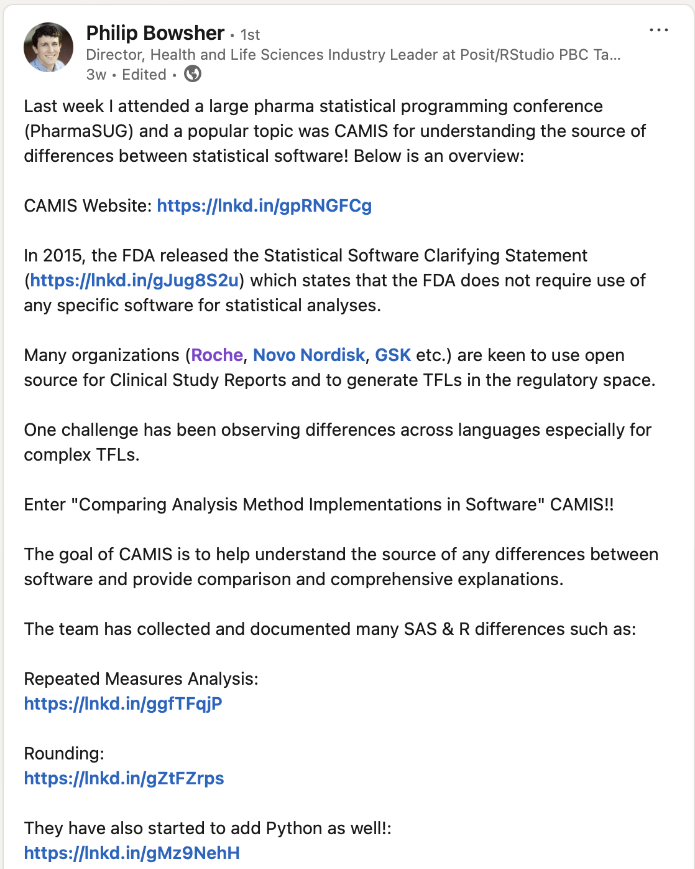
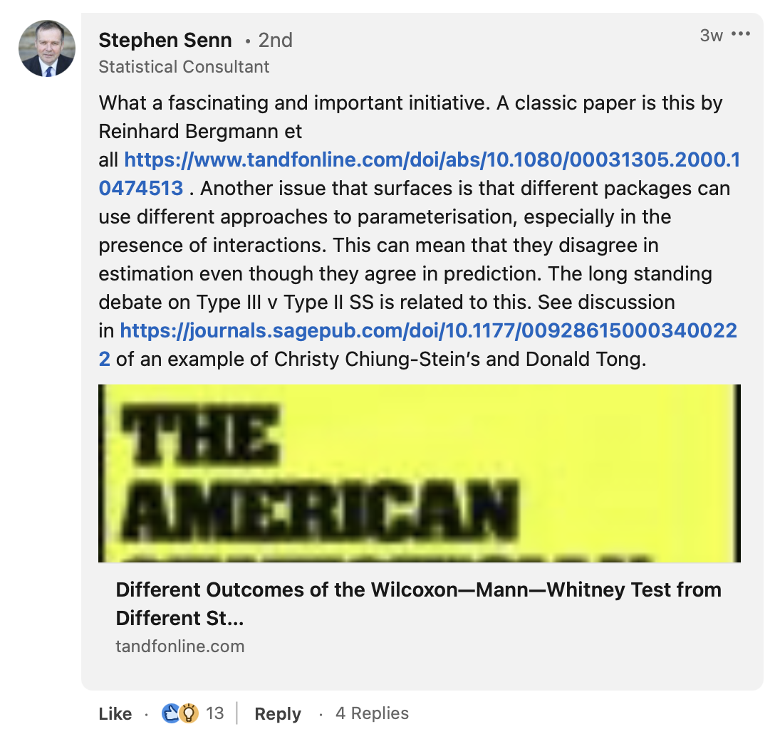

Ongoing discussions
Full discussion and post:

Slide 18
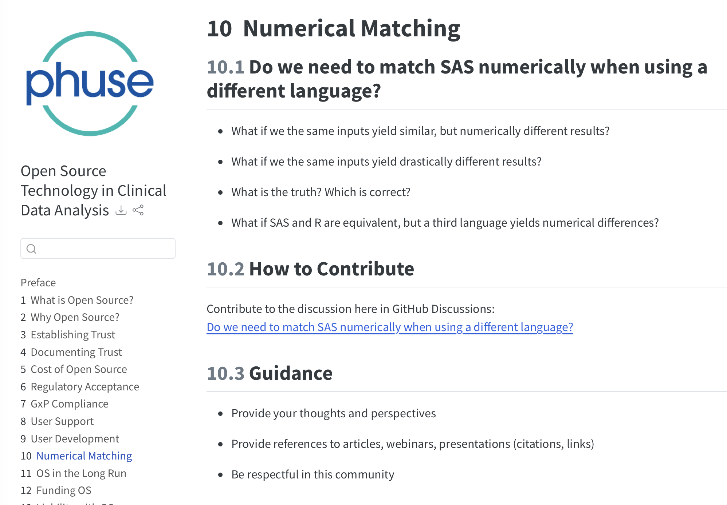
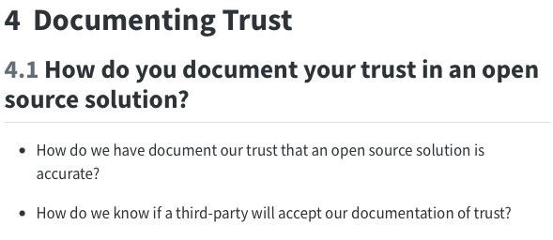
Ongoing discussions
PHUSE Open Source Technology in Clinical Data Analysis WG
https://github.com/phuse-org/OSTCDA/discussions/
They have a community call to discuss relevant topics

Slide 19
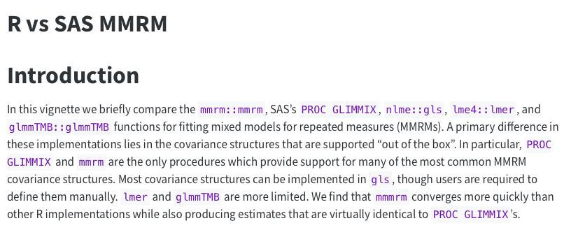
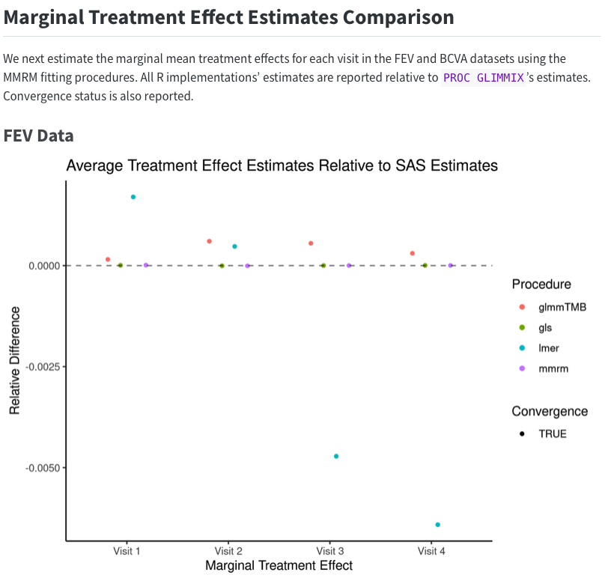
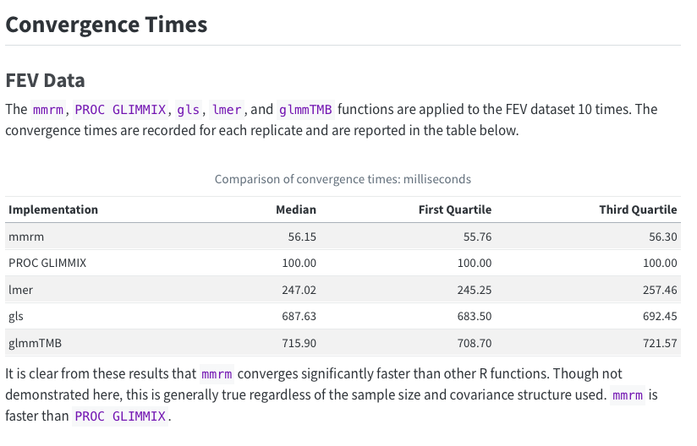
Collaboration
openstatsware - mmrm
Possibility to add the Bayesian implementation as well

Slide 20

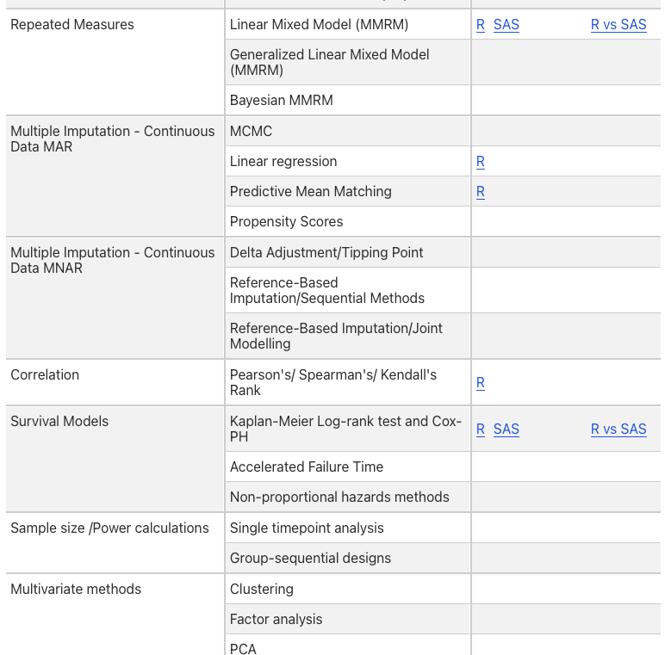
Collaboration
Academia - dissertation
We are open to students, researcher (academia / industry) who want to team up for dissertation projects
Example: a comparison of MMRM methodology in SAS and R software (ongoing)
A good combination of methodology and implementation with real-world applications
Contact us for more information!

Slide 21





CAMIS has something for everyone
Topic of importance for the biopharma industry as well as research
Like to be intellectually challenged and fascinated on something subtle
Read CAMIS Documents
Collaborate, network and make new friends
Learn new topics on statistics and programming

Slide 22
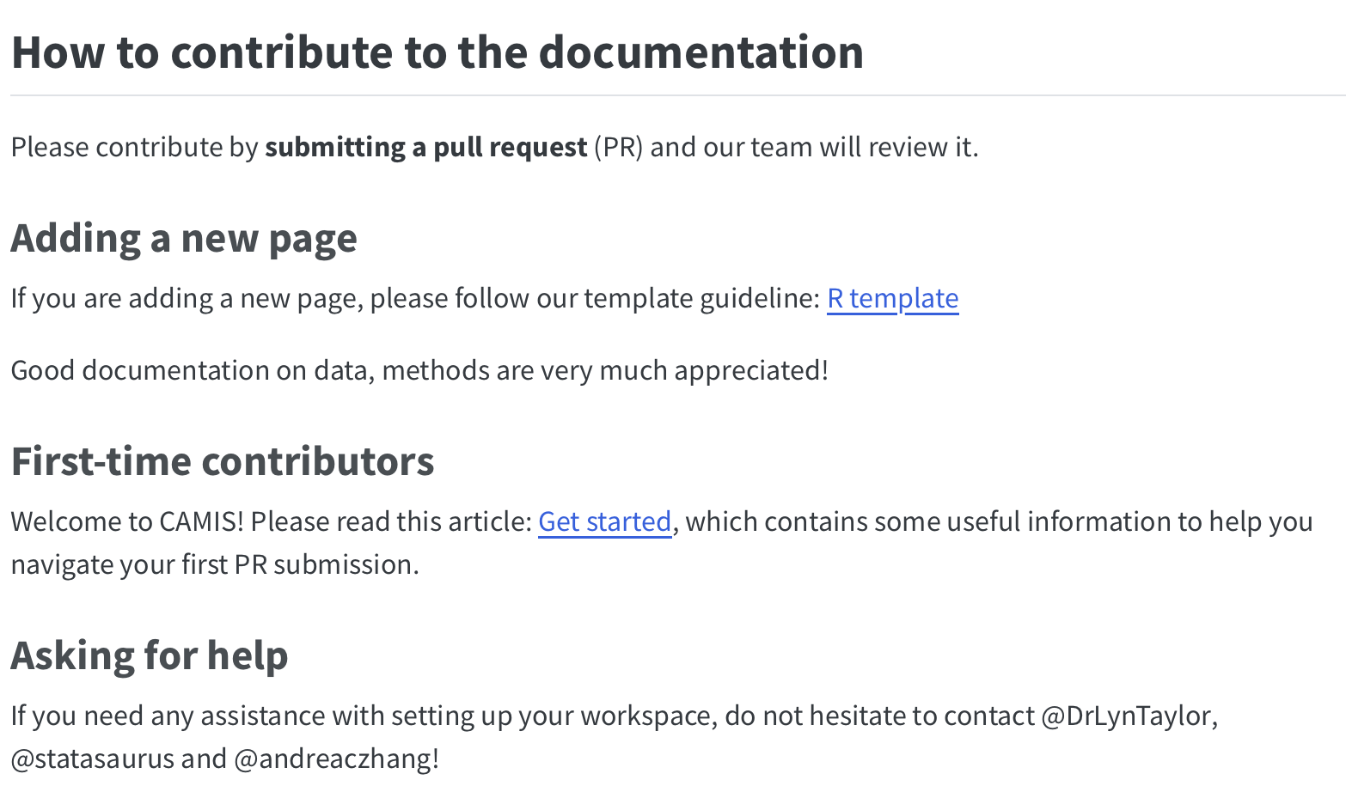
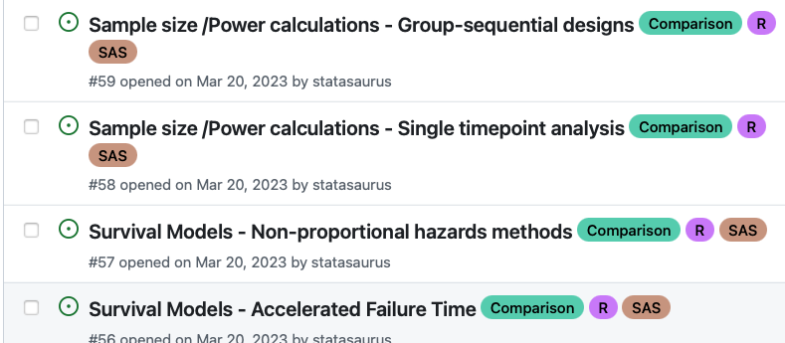
How to get started
Contribution guidelines for new contributors
R template for topics to cover
Also we have information for contributors who are new to GitHub and Pull Request
Get started: check our open issues and comment to indicate your interest, or send us a message
We aim to close 45 issues this year - 37 so far
Help us achieve the goal :)

Slide 23
Resources
CAMIS website: https://psiaims.github.io/CAMIS/
GitHub Repo: https://github.com/PSIAIMS/CAMIS/
Open issues: https://github.com/PSIAIMS/CAMIS/issues
PHUSE discussions
Do we need to match SAS numerically when using a different language? https://github.com/phuse-org/OSTCDA/discussions/11
How to document your trust in an open source solution? https://phuse-org.github.io/OSTCDA/doc_trust.html
Please feel free to reach out to the co-leads, you can find us on LinkedIn
Lyn Taylor Christina Fillmore Harshal Khanolkar Chi Zhang
Contact
Website: https://andreaczhang.github.io/ LinkedIn: Chi Zhang Email: chi.zhang@medisin.uio.no

